Slide 1
Updates on ANCCA Website

Slide 2
Current website
homepage

Slide 3
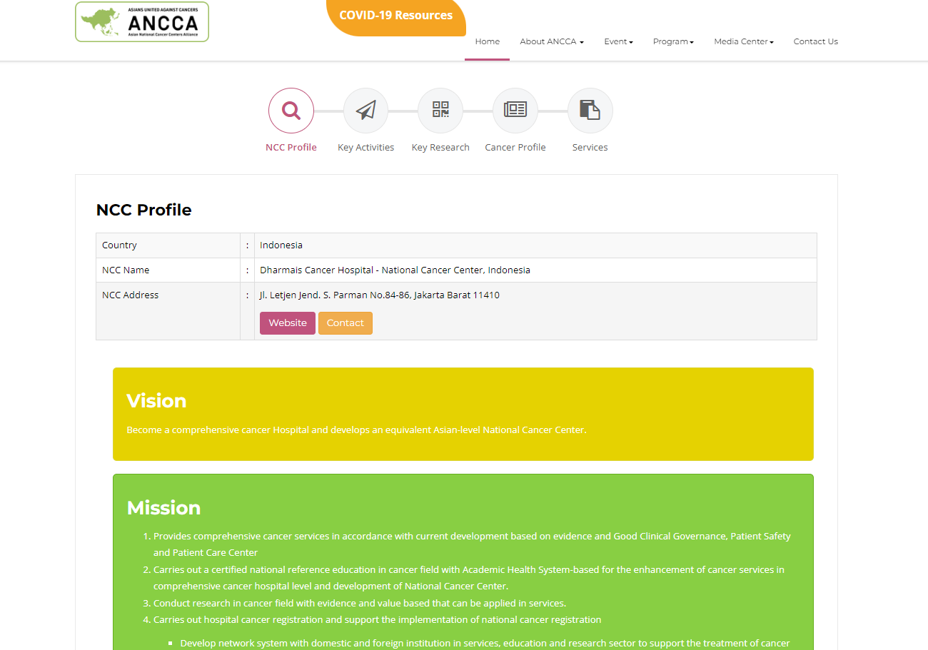
Current website

Slide 4
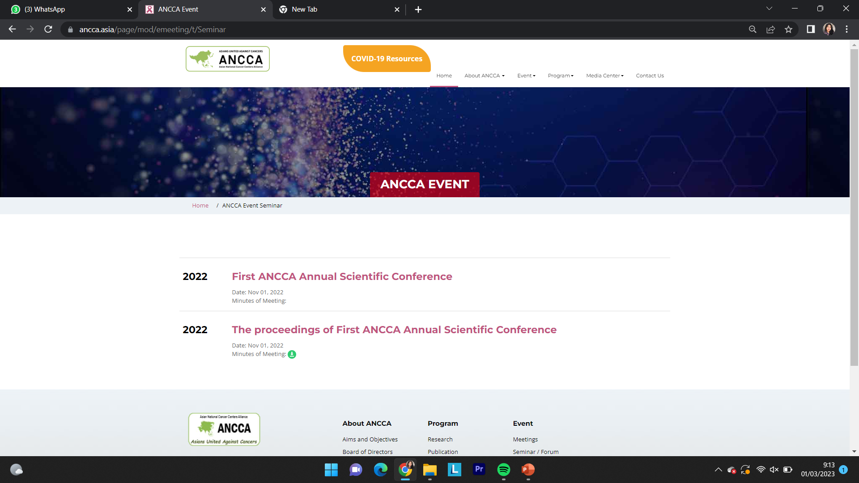
Current website

Slide 5
New template
https://ancca.asia/ancca2/

Slide 7
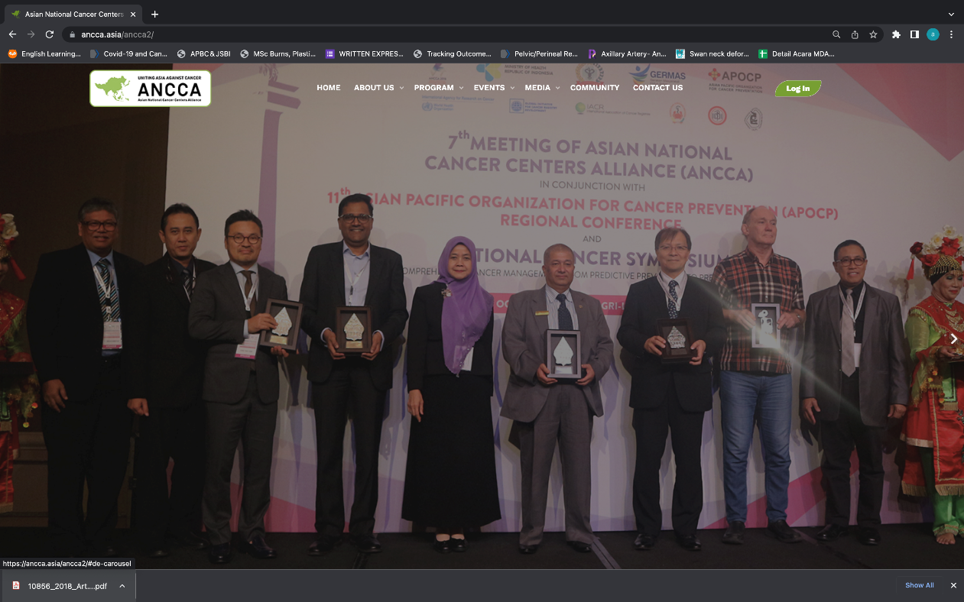
Home page
Main Page :
Sliding photos
Menu and Sub Menu
Members
News
Board of Directors (Ancca Secretariat)
Events
only website team can access the main homepage

Slide 8
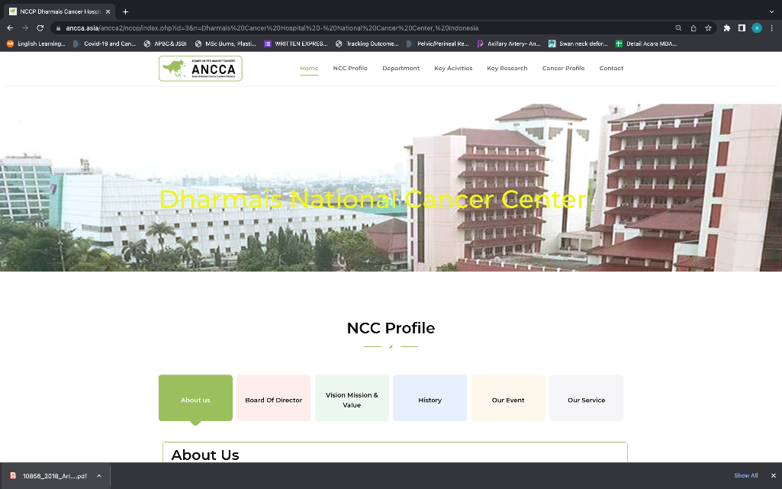
NCC Homepage
Member page: https://ancca.asia/ancca2/page-member.htm
Each NCC must give us their email for the website account ( 1 country, 1 account)
Each account will be able to access their own NCC homepage
Each NCC must submit their own information

Slide 9
Benefits
Easily modified homepage to present current events/issues
Each country get one username and password to access their country homepage to update its own content.
But, only website team can access the main homepage.

Slide 10
Progress
Submitting previous MoM into new website
Launching ANCCA’s new website when the website is complete

Slide 11
Subcommittees

Slide 12
SC1 Cervical Cancer Screening
SC2 Strategic NCCP in ANCCA
SC3 Asian Code Agains Cancer
SC4 Cancer Registries
SC5 Education and Training
SC6 Research and Clinical Trials
SC7 Publicity, Philantropy and Partnership
SC8 COVID-19 and future pandemics
SC9 Tobacco-free zone
Current Situation : Indonesia participated in SC7

Slide 13
Thank You

